Slide 1


Slide 2
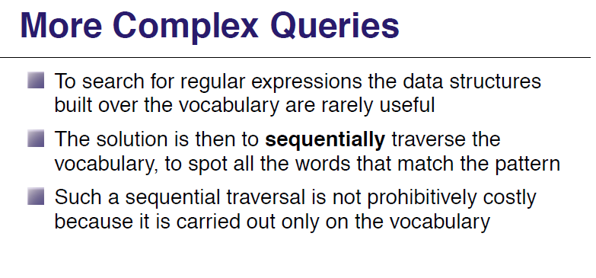

Slide 3
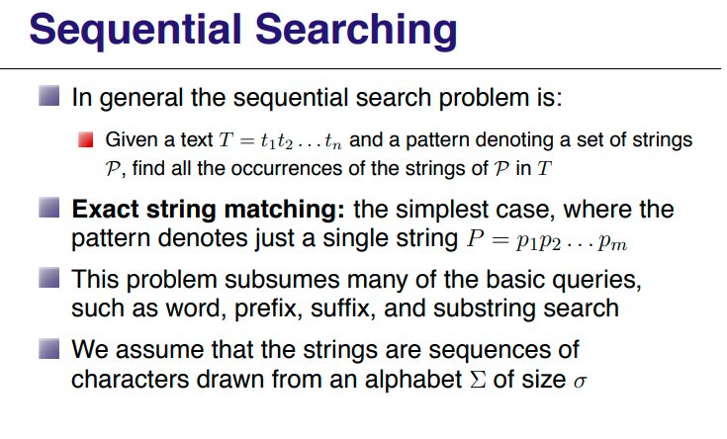

Slide 4
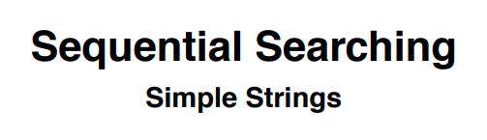

Slide 5
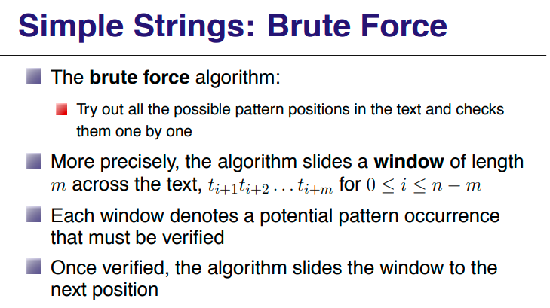

Slide 6
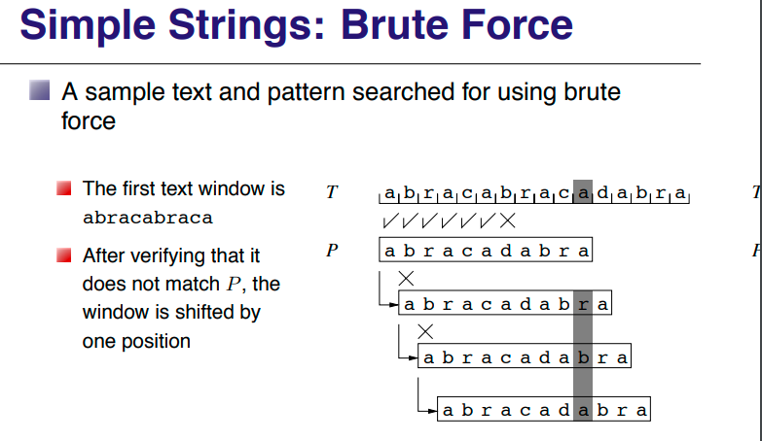

Slide 7
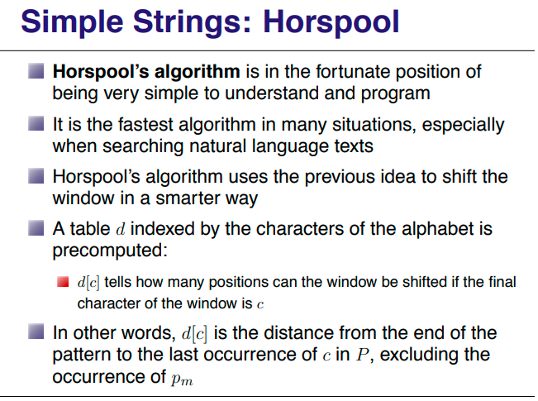

Slide 8
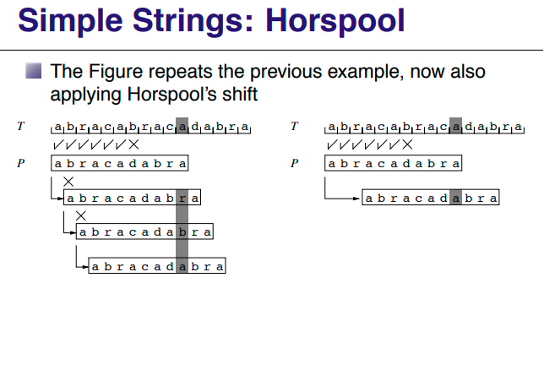

Slide 9
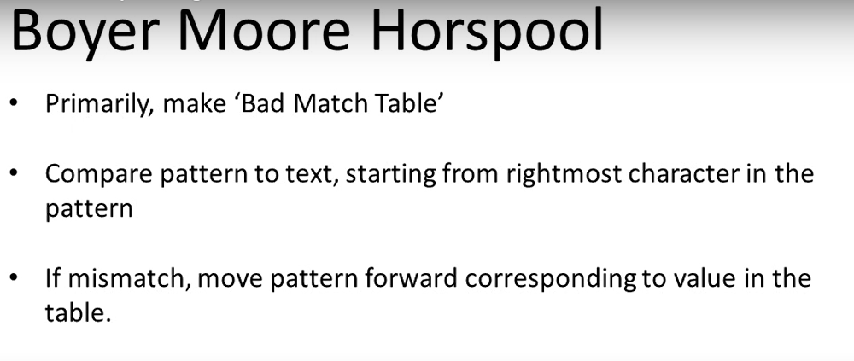

Slide 10
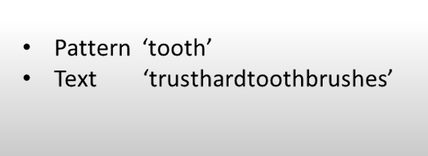
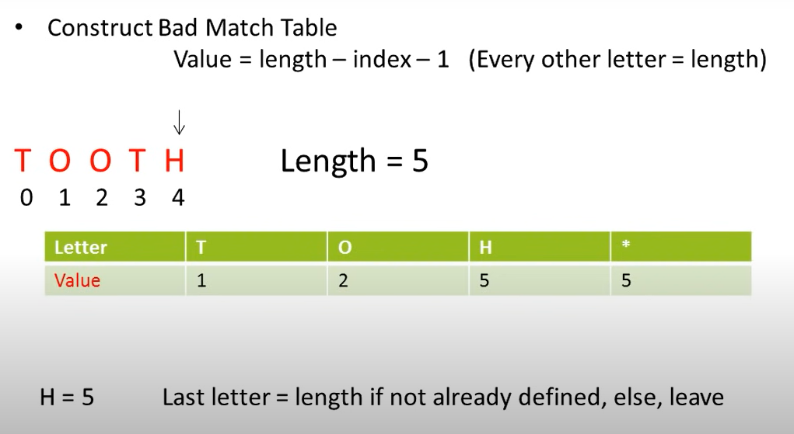

Slide 11
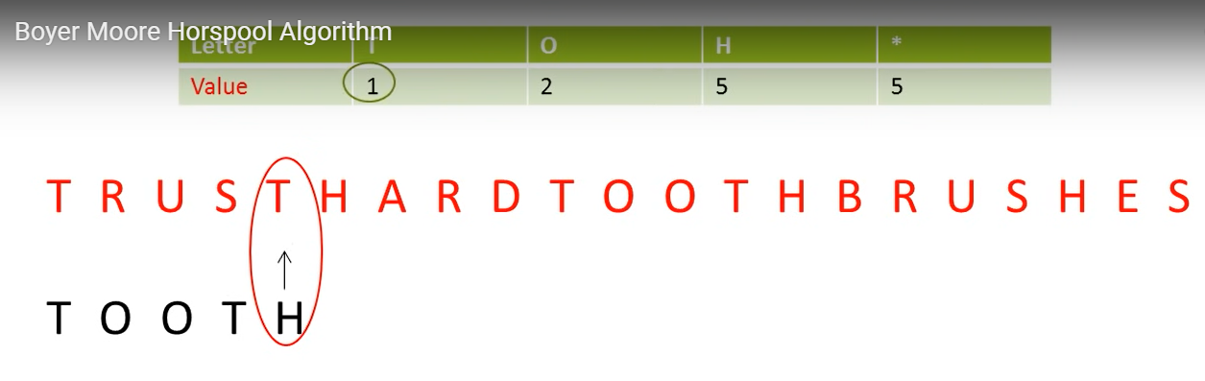

Slide 12
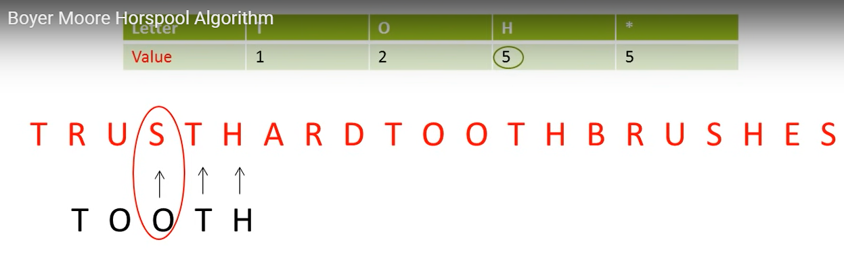

Slide 13
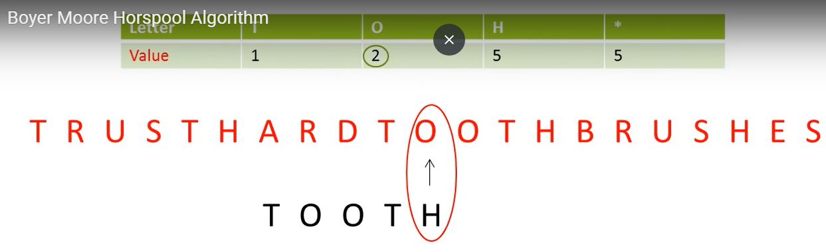

Slide 14
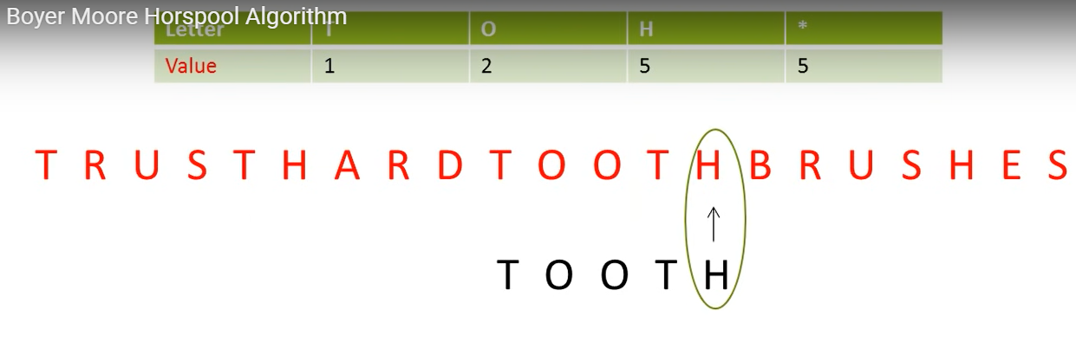

Slide 15
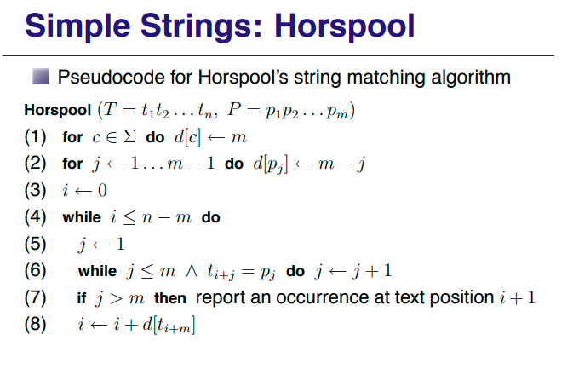

Slide 16
SIMILARITY SEARCH

Slide 17
web user information needs are represented by keyword queries
document relevance is defined in terms of how close a query is to documents found by the search engine
web search queries are usually incomplete and ambiguous, many of the documents returned may not be relevant to the query

Slide 18
However, once a relevant document is found, a larger collection of possibly relevant documents may be found by retrieving documents similar to the relevant document.
This process, called similarity search, is implemented in some search engines (e.g., Google) as an option to find pages similar or related to a given page.
The intuition behind similarity search is the cluster hypothesis in IR, stating that documents similar to relevant documents are also likely to be relevant.

Slide 19
Cosine Similarity
There is an alternative to cosine similarity, which appears to be more popular in the context of similarity search
Jaccard Similarity
similarity between two Boolean document vectors

Slide 20
Jaccard coefficient

Slide 21
Jaccard coefficient defined on sets
Let us denote the set of terms that occur in document d as T (d). Then the similarity between two documents sim (d1, d2) is defined as

Slide 22
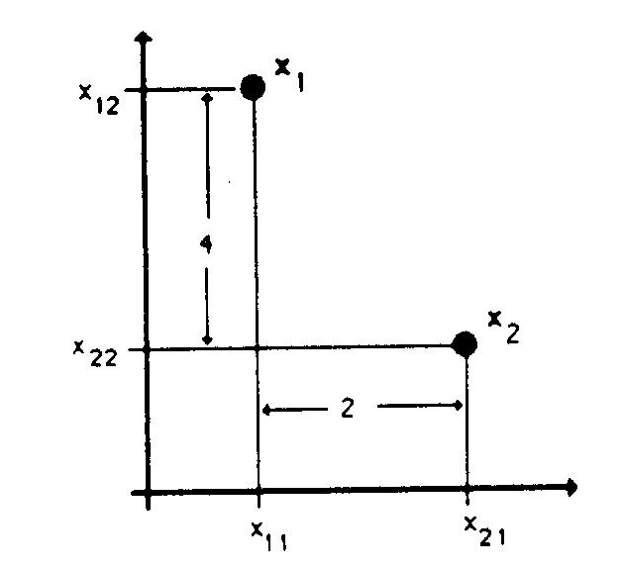
Distance Measures („Metrics“):
Euclidian distance:
[(x₁₁ - x₂₁) ² + (x₁₂ - x₂₂)²] ^{1/2} =
= (4² + 2²)^{1/2} = 4.472
Manhattan (Hamming) distance:
|x₁₁ - x₂₁| + |x₁₂ - x₂₂| = 4 + 2 = 6
Sup distance:
Max (|x₁₁ - x₂₁|, |x₁₂ - x₂₂|) =
= Max (4, 2) = 4

Slide 23
Special Cases of Minkowski Distance
h = 1: Manhattan (city block, L₁ norm) distance
E.g., the Hamming distance: the number of bits that are different between two binary vectors
h = 2: (L₂ norm) Euclidean distance
23
Notes:
23

Slide 24
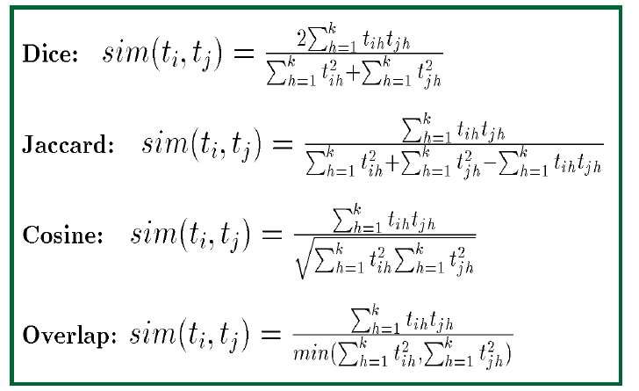
Similarity measures in arithmetic terms

Slide 25
Example calculation
Let us say D1 = < 3 4 5 6>
D2 = <1 2 3 4>
L1 = sqrt(3*3+4*4+5*5+6*6) = sqrt(86)
L1*L1 = 86
L2 = sqrt(1*1+2*2+3*3+4*4) = sqrt(30)
L2*L2 = 30
|D1.D2| = (3*1+4*2+5*3+6*4) = 50
|D1.D1| =(3*3+4*4+5*5+6*6) = 86
|D2.D2| = (1*1+2*2+3*3+4*4) = 30
Dice similarity(1,2) = 2*50/(86+30) = 100/116 = 0.86
Jaccard similarity(1,2) = 50/(86+30-50) = 50/66= 0.76
Dice similarity (1,1) = 2*86/(86+86) = 1
Jaccard similarity(1,1) = 86/(86+86 -86) = 1
Dice similarity(2,2) = 2*30/(30+30) = 1
Jaccard similarity(2,2) = 30/(30+30-30) = 1

Slide 26
Document Resemblance
Jaccard coefficient computed
with shingled documents

Slide 27
Document similarity vs document resemblance
D1: India beat England
D2: England beat India
Find 2-grams
No overlap
No/zero document resemblance, r₂(D1,D2)=0
Document similarity, yes/JC =1

Slide 28
EVALUATING SEARCH QUALITY

Slide 29
Recall represents the proportion of relevant documents retrieved to all relevant documents

Slide 30
Statistical properties of terms in information retrieval

Slide 31
Heaps’ law: Estimating the number of terms

Slide 32
Zipf’s law: Modeling the distribution of terms

Slide 34
f_{a}= C/i, i=1, C=f_{a}; f_{b}= C/2………

Slide 36
example
Hebenon, a poison referred to in Shakespeare's 'Hamlet' only once

